Slide 1
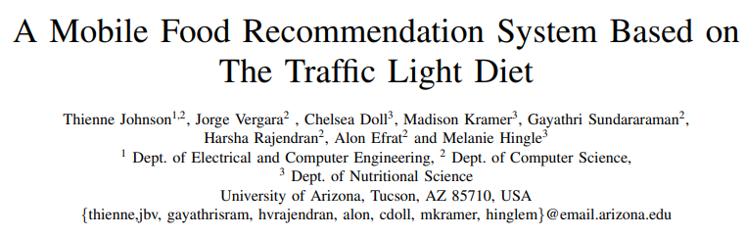
2021. 01. 06
Presented by
Md. Tanvir Ahemd
IT Convergence and Application Engineering
Pukyong National University, Korea

Slide 2
Contains
Abstract
Introduction
System Architecture
Evaluation
Discussion
Conclusion

Slide 3
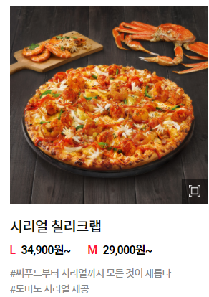
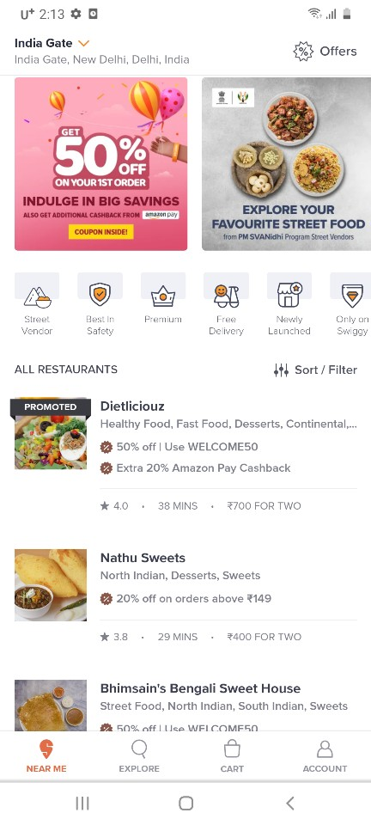
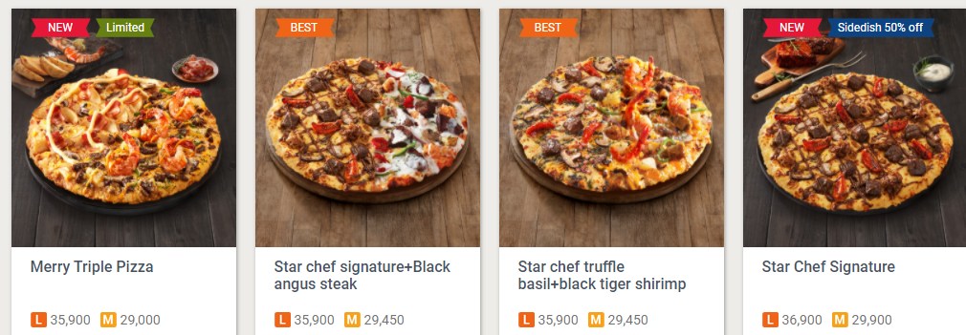
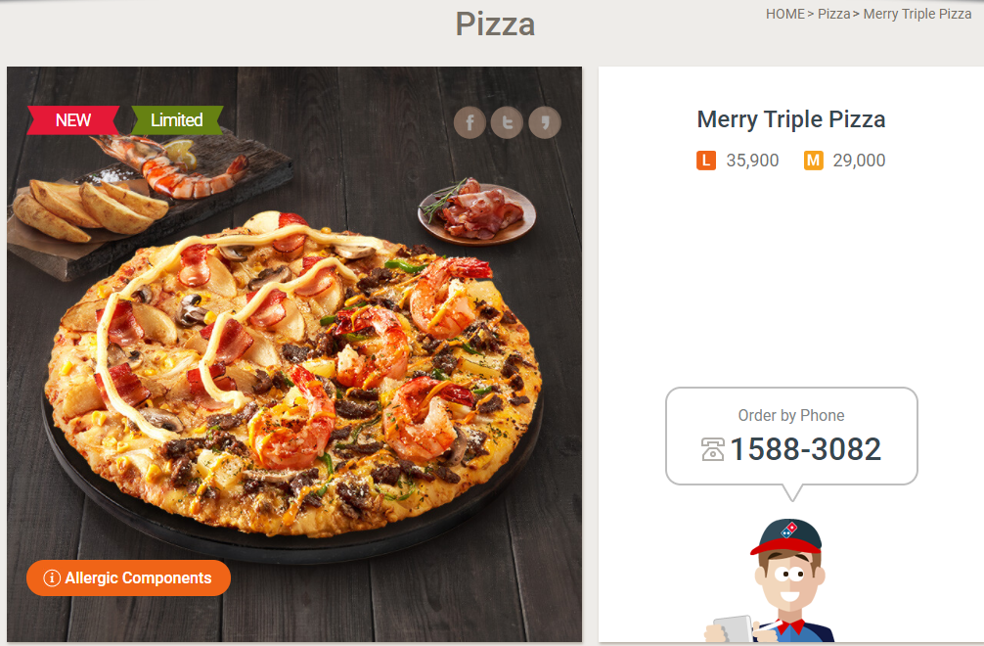
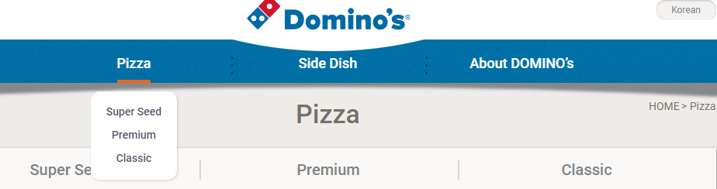
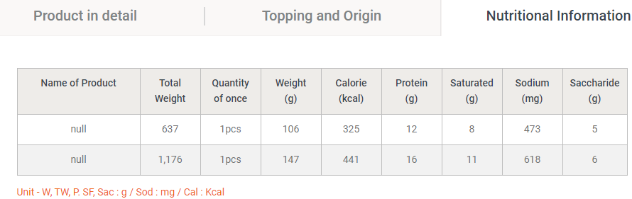
Abstract
Recommendation System
Restaurant First View
Item First View
Home Food
Personalized Dish Collections
Menu Recommendation
Menu Detail
Food Detail information

Slide 4
Abstract
Recommendation System Ideas
Understanding Customer
Match Marking
Understanding Restaurants & Food Items
Test Profile
Veg/Non-Veg
Single/Family
Explorer
Cravers
Price Affinity
Offer Affinity
Weekend/Weekdays
Home/Work
Health Quotients
Speed
Brand centric
Test Profile
Dish
Cuisine
Pure Veg/Pure non-Veg
Offers
Popular
Exclusive
Brand
CFT
Ratings
Healthy
Notes:
https://www.youtube.com/watch?v=fRXWHJlgmHA

Slide 5
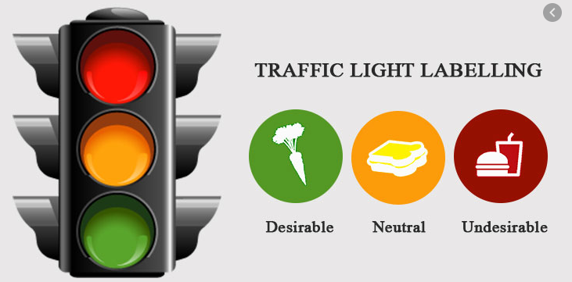
Introduction
What is Traffic Light Food Recommendation System?

Slide 6
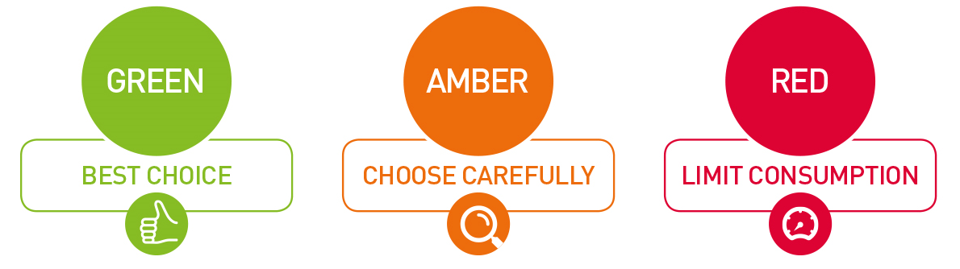
Introduction
What is Traffic Light Food Recommendation System?

Slide 7

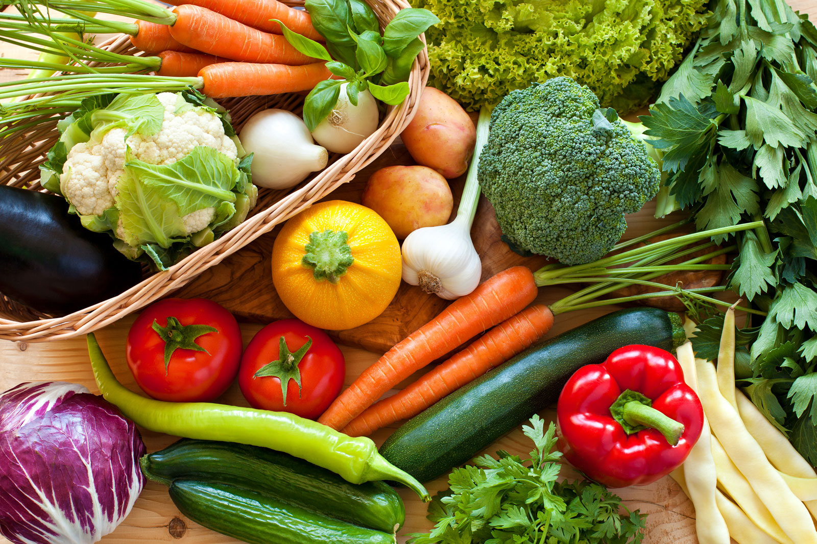
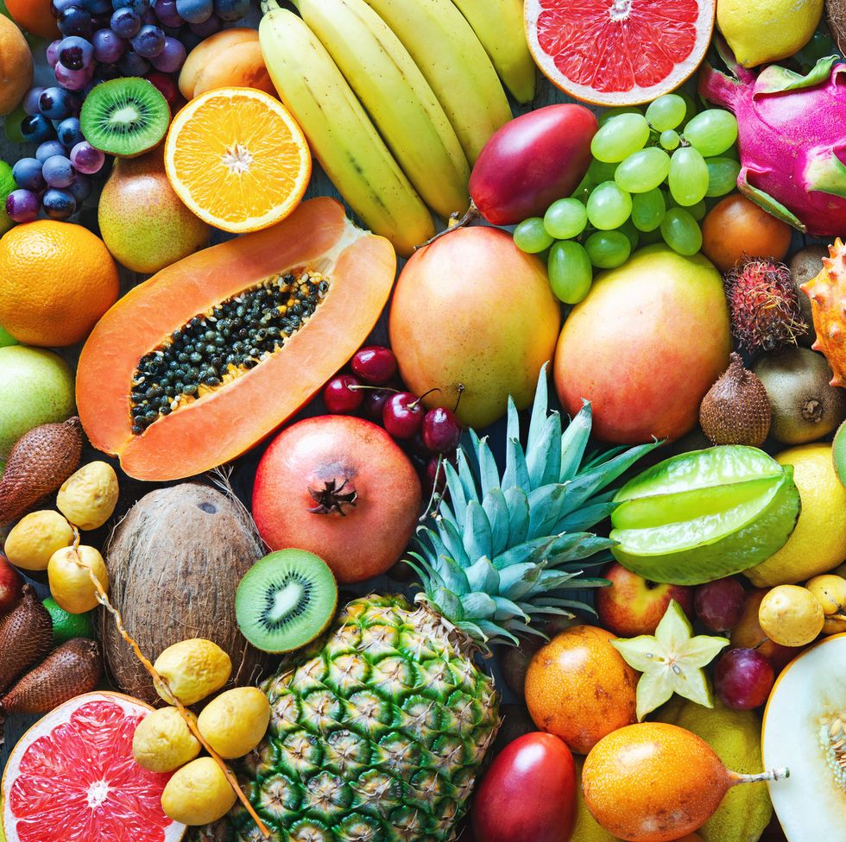

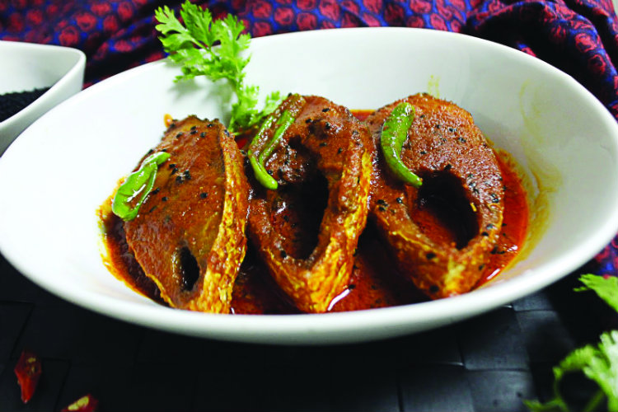
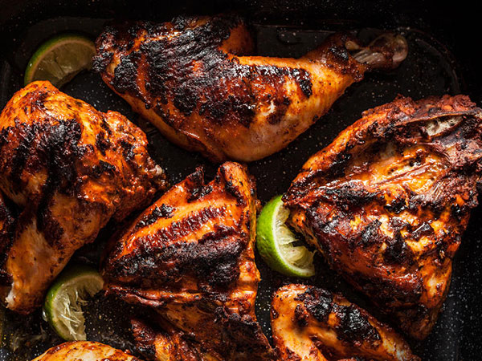

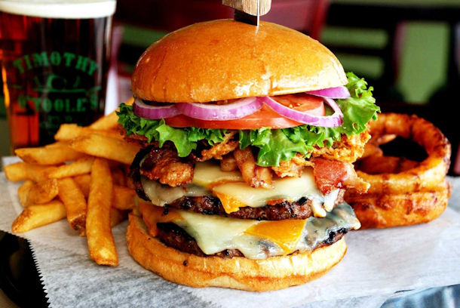
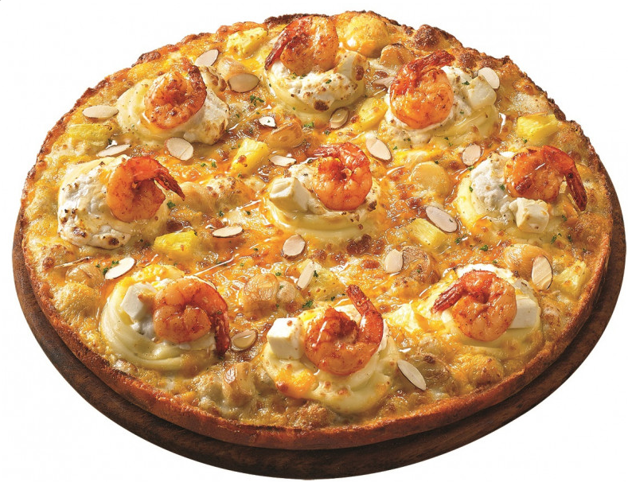
Introduction
Traffic Light Food Example

Slide 8
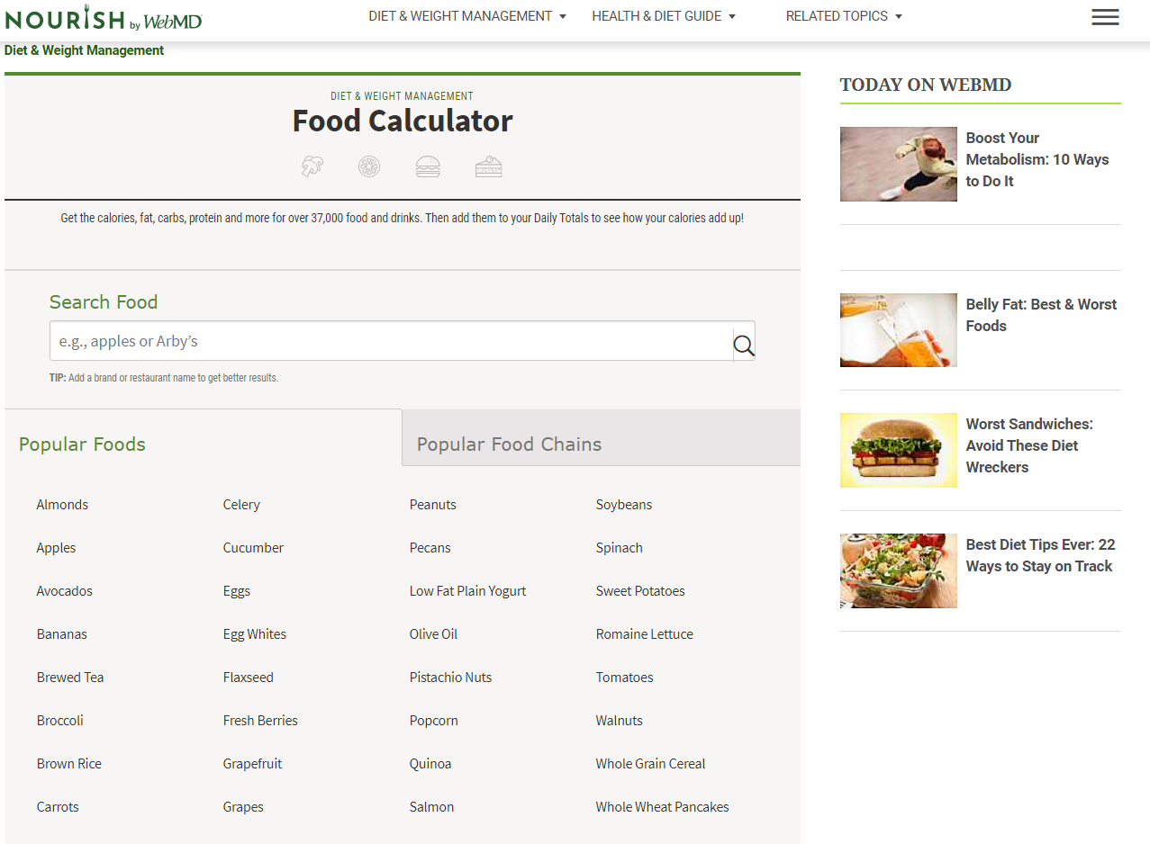
Introduction
Foods App (Calorie Count)

Slide 9
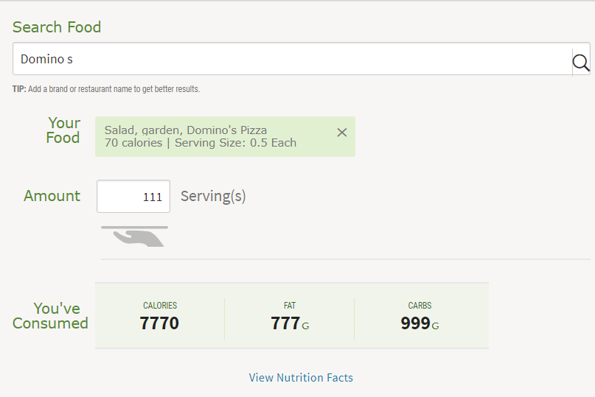
Introduction
Food Search

Slide 10
Introduction
Food Calories Calculation

Slide 11
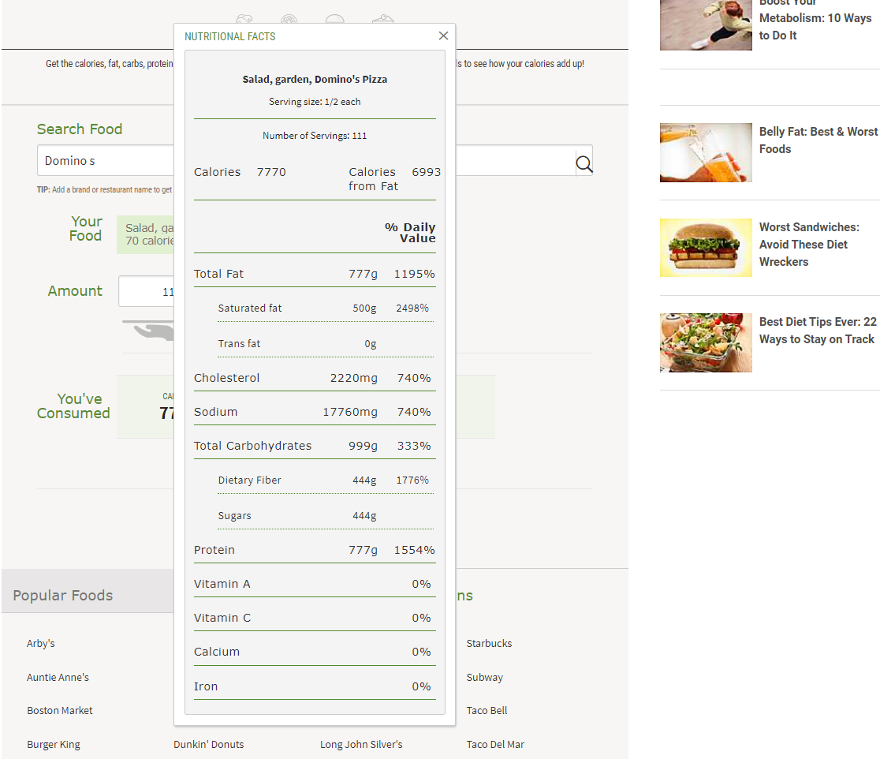
Introduction
Food Calories Calculation Detail Description

Slide 12
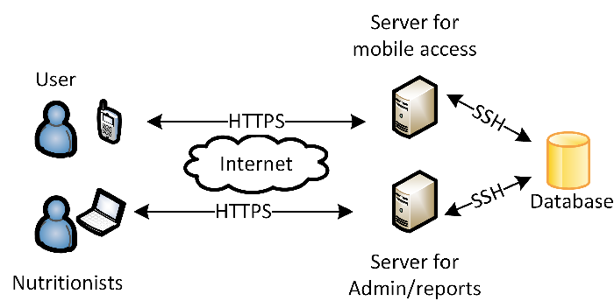
System Architecture
“Foodtracker” app Scenario

Slide 13
System Architecture
User base app Working Process
A. Web server and services
SSH (Secure Shell Protocol)
HTTPS (Hypertext Transfer Protocol Secure)

Slide 14
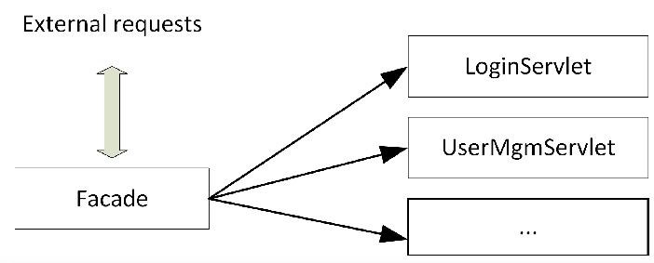
System Architecture
User base app Working Process

Slide 15
System Architecture
User base app Working Process
Pizza
Burger
Pasta
Cook
Cook
Cook
Waiter
Client
Notes:
Facade design = Mask/Hide complete of implementation

Slide 16
System Architecture
User base app Working Process
Pizza
Burger
Pasta
Cook
Cook
Cook
Waiter
Client
Notes:
Facade design = Mask/Hide complete of implementation

Slide 17
System Architecture
User base app Working Process
Pizza
Burger
Pasta
Cook
Cook
Cook
Facade design
Waiter
Client
Notes:
Facade design = Mask/Hide complete of implementation

Slide 18
System Architecture
HTTPS base app Working Process
B. Automated Menu Parser
SSH (Secure Shell Protocol)
HTTPS (Hypertext Transfer Protocol Secure)

Slide 19
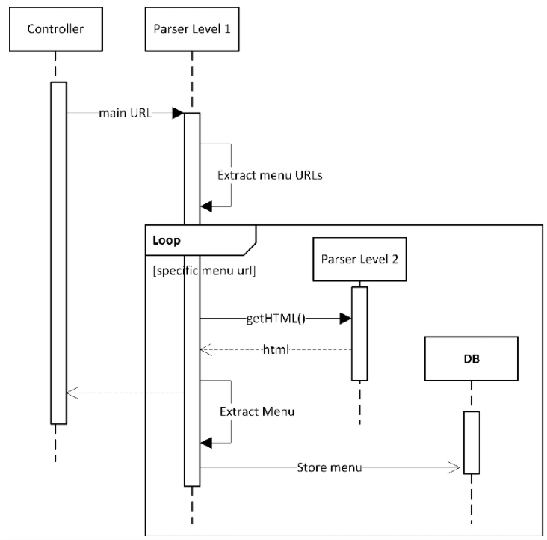
System Architecture
HTTPS base app Working Process

Slide 20
System Architecture
HTTPS base app Working Process

Slide 21
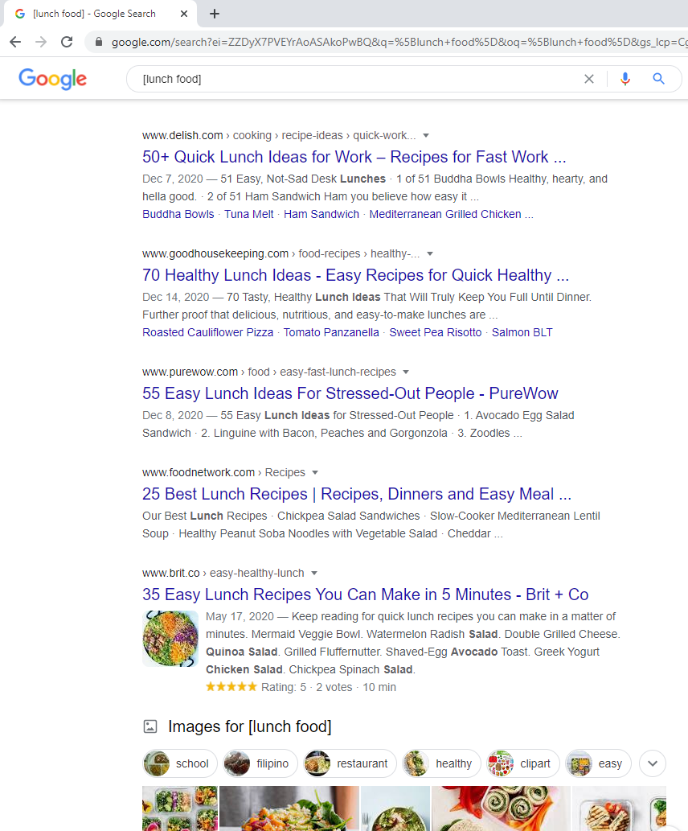
System Architecture
HTTPS base app Working Process
Search Keyword
Search Result

Slide 22
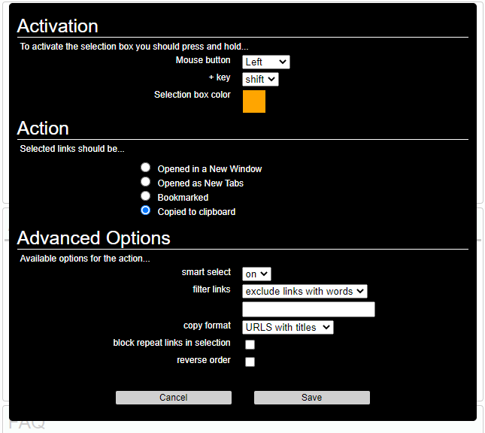
System Architecture
HTTPS base app Working Process “LICKCLUMP” Setting

Slide 23
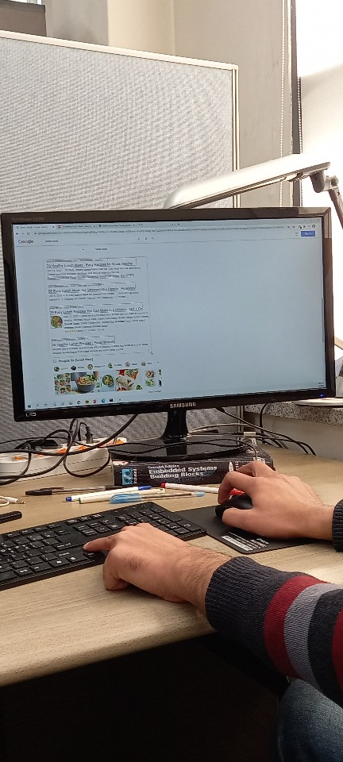
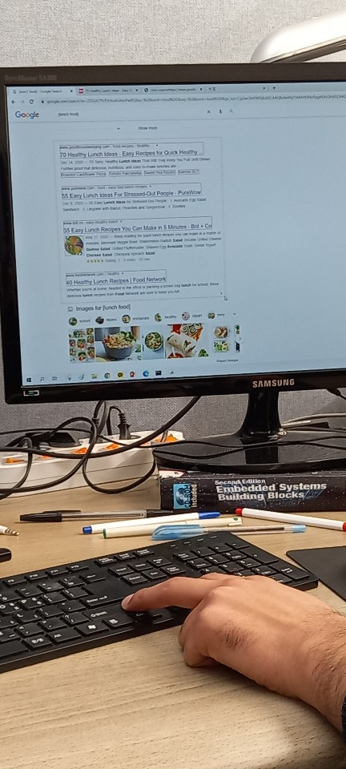
System Architecture
Python Program “url” collect Using “LICKCLUMP”
LICKCLUMP
Press (Keyboard) =
“Shift” + “Mouse_Right Button”

Slide 24
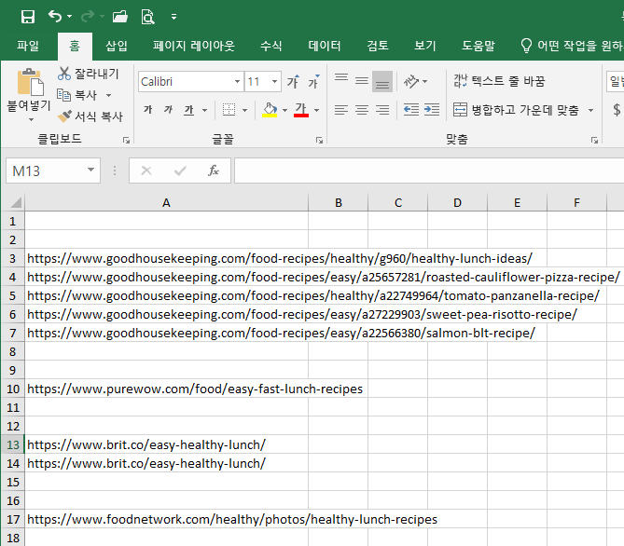
System Architecture
Python Program “url” collect Using “LICKCLUMP”
LICKCLUMP
Press (Keyboard) =
“Shift” + “Mouse_Right Button”

Slide 25
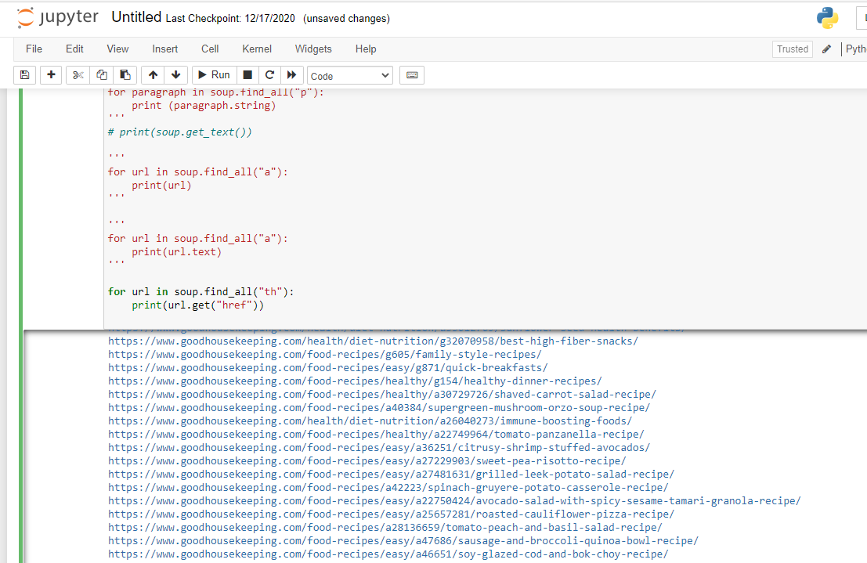
System Architecture
Python Program “url” collect

Slide 26
System Architecture
User and HTTPS bases app Working Process
B. Automated Menu Parser
SSH (Secure Shell Protocol)
HTTPS (Hypertext Transfer Protocol Secure)

Slide 27
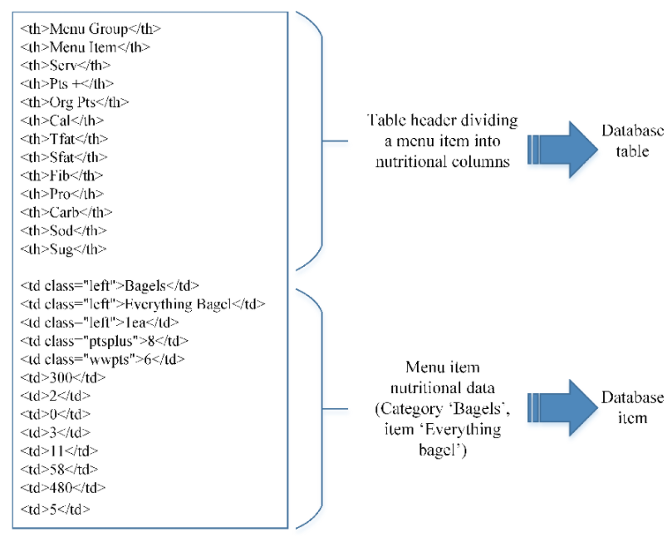
System Architecture
User and HTTPS bases app Working Process

Slide 28
System Architecture
“Foodtracker” app Working Process
C. Foodtracker App
SSH (Secure Shell Protocol)
HTTPS (Hypertext Transfer Protocol Secure)

Slide 29
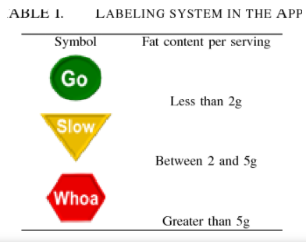
System Architecture
“Foodtracker” app Working Process
C. Foodtracker App
1) The Traffic Light Diet:

Slide 30
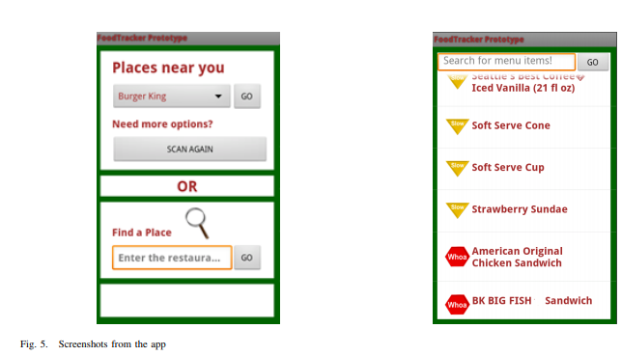
System Architecture
“Foodtracker” app Working Process
C. Foodtracker App
2) App Details:

Slide 31
System Architecture
“Foodtracker” app Screen Layout
C. Foodtracker App
2) App Details:
Google Maps API
User Location Identify

Slide 32
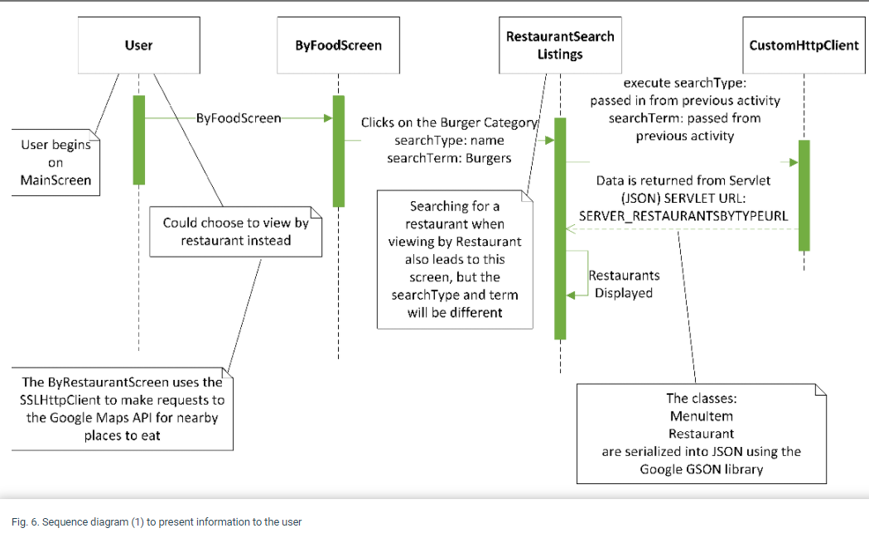
System Architecture
Sequence Diagram
JavaScript Object Notation (JSON)
C. Foodtracker App
2) App Details:

Slide 33
System Architecture
Sequence Diagram
What is SSH? How It is Work?

Slide 34
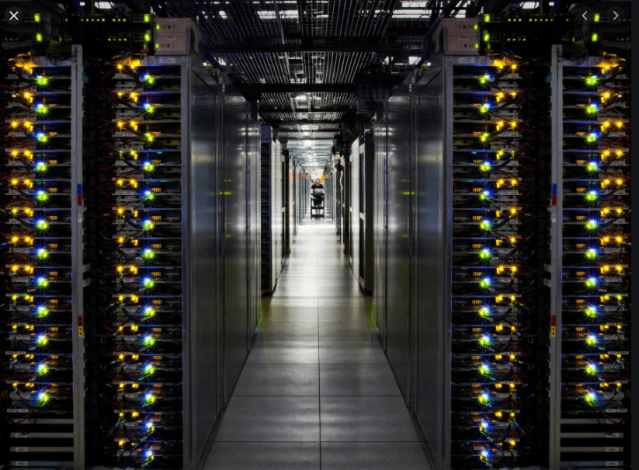

System Architecture
What Is SSH?
SSH
Secure Shell
a-----
-----
------
INTERNET
SSH Server
SSH Client
Secure shell is a network protocol for securing data that flows between a client and a server over a public network such as internet.
When a client connects to a server it needs to be verified so the transaction can be considered secure.

Slide 35


System Architecture
What Is SSH?
SSH
Secure Shell
a-----
-----
------
INTERNET
Cryptographic keys
SSH Server
SSH Client

Slide 36

System Architecture
What Is SSH?
SSH
Secure Shell
a-----
-----
------
INTERNET
TUNNEL
Cryptographic keys
SSH Server
SSH Client

Slide 37
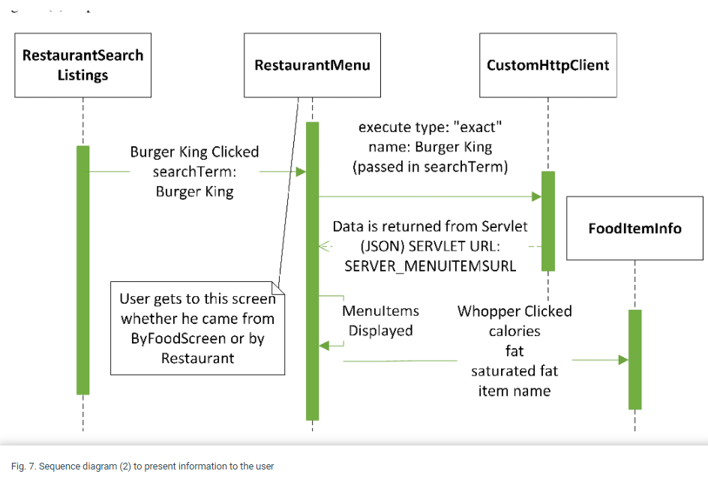
System Architecture
“Foodtracker” app Working Sequence
Descriptions
When The user choose “Burger King”.
A new request is sent to the server.
The server returns a new JSON array containing the menu items for this restaurant.

Slide 38
System Architecture
“Foodtracker” app Working Sequence
Descriptions
When The user choose “Burger King”.
A new request is sent to the server.
The server returns a new JSON array containing the menu items for this restaurant.
A JSON file is a file that stores simple data structures and objects in JavaScript Object Notation (JSON) format, which is a standard data interchange format.

Slide 39
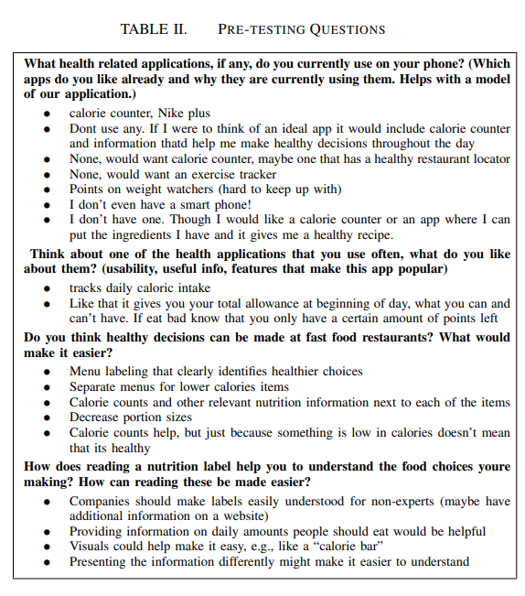
Evaluation
Pre testing phase

Slide 40
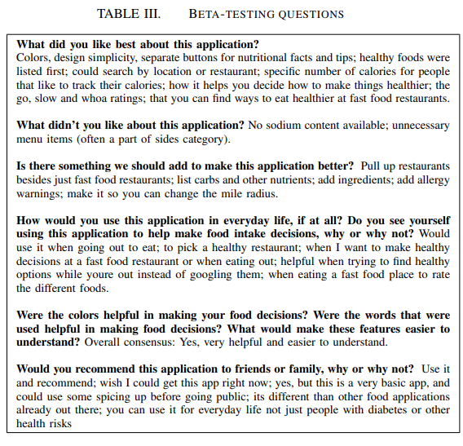
Evaluation
Beta-Testing Phase

Slide 41
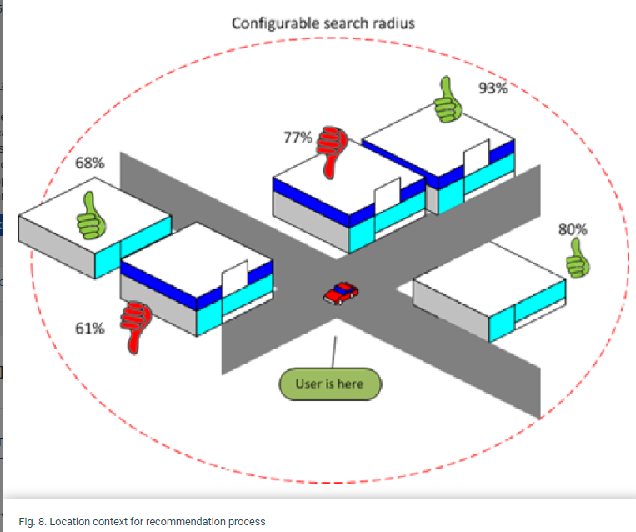
Discussion
The Recommendation Comparison
The Green thumbs represent a good choice of healthy food items.
The red color represent a restaurant with not so many good choices.

Slide 42
Conclusions
Conclusions
The prototype was functional, and users evaluation suggested that the product is useful.
The application and database were built to be HIPAA (Health Insurance Portability and Accountability Act).
The tracking feature to allow users to document their choices and recording how many “red” food items they ate that day/week/month.
In addition, tracking choices to location could provide valuable insight into the types of foods and energy density of foods consumed at different types of fast food restaurants

Slide 43
Q & A

